Slide 1
What ? FL
Vimalkumar Kumaresan Ph.D

Slide 3
Model:
Model is a working representation of the dynamics within some desired system.
Types:
White-box Model
Black-box Model

Slide 4
Federated Learning = Federated + Learning
= Decentralized + Learning
= Distributed + Learning
Federated learning is a method to synthesize global models from local models trained on the edge.

Slide 5
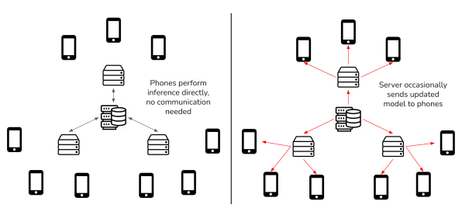
Edge Inference
Note: Edge Inference is different than Edge Training.

Slide 6
Formalization
L = {l₁ , l₂ ,l₃ ,..... l_{n}}
Federated Averaging (FedAvg) is an aggregation algorithm which perform parameter-wise arithmetic mean across local models l_{i}
G = FedAvg(L)

Slide 7
FL Process
The steps for a round can be described as follows:
1. The aggregate global model parameters are sent to each user’s device.
2. The received ML models located on the user devices are trained with local data.
3. After a certain amount of training, the local model parameters are sent to the central server.
4. The central server aggregates the local models by applying an aggregation function, producing
a new aggregate global model

Slide 8
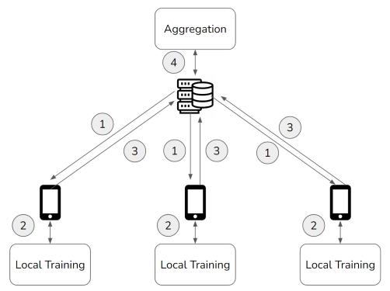
FL Process (II)

Slide 9
FL is similar to Transfer Learning(TL) which uses parameter freezing technique.
FL + TL = FTL => Personalization
Types of FL:
Horizontal or Homogenous FL
Vertical or Heterogeneous FL

